Slide 1
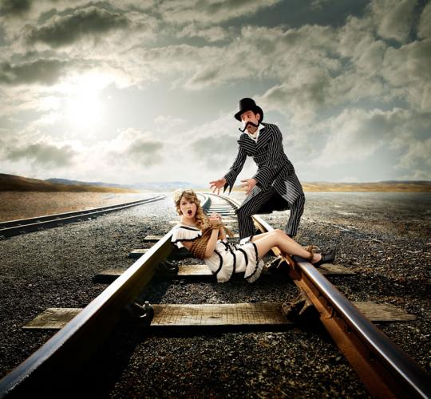
Rhetorical Analysis of ‘Mean’ by Taylor Swift

Slide 2
“Mean”
You, with your words like knives / And swords and weapons that you use against me, / You, have knocked me off my feet again, / Got me feeling like I’m nothing. / You, with your voice like nails on a chalkboard / Calling me out when I’m wounded. / You, pickin’ on the weaker man. / Well you can take me down, / With just one single blow. / But you don’t know, what you don’t know, / Someday, I’ll be living in a big old city, / And all you’re ever gonna be is mean. / Someday, I’ll be big enough so you can’t hit me, / And all you’re ever gonna be is mean, / Why you gotta be so mean? / You, with your switching sides, / And your wildfire lies and your humiliation / You, have pointed out my flaws again, / As if I don’t already see them. / I walk with my head down, / Trying to block you out cause I’ll never impress you / I just wanna feel okay again. / I bet you got pushed around, / Somebody made you cold, / But the cycle ends right now, / You can’t lead me down that road, / You don’t know, what you don’t know / Someday, I’ll be, living in a big old city, / And all you’re ever gonna be is mean. / Someday, I’ll be big enough so you can’t hit me, / And all you’re ever gonna be is mean. / Why you gotta be so mean? / And I can see you years from now in a bar, / Talking over a football game, / With that same big loud opinion but, / Nobody’s listening / Washed up and ranting about the same old bitter things / Drunk and grumbling on about how I can’t sing / But all you are is mean, / All you are is mean. / And a liar, and pathetic, and alone in life,/ And mean, and mean, and mean / and mean / But someday, I’ll be, living in a big old city / And all you’re ever gonna be is mean. / Yeah, Someday, I’ll be big enough so you can’t hit me, / And all you’re ever gonna be is mean. / Why you gotta be so ? / Someday, I’ll be, living in a big old city, / And all you’re ever gonna be is mean. / Yeah, Someday, I’ll be big enough so you can’t hit me, / And all you’re ever gonna be is mean. / Why you gotta be so mean?

Slide 3
Subject
The subject is frustration over people in her life that have generally just been huge jerks to her. She’s kind of venting through song.

Slide 4
Occasion/Context
The text reveals that our society judges everything and everyone too harshly. It forgets that people have feelings, and, as hard as it may be to believe, considering that we’re used to seeing them as perfection, celebrities are human too.
“You have pointed out my flaws again as if I don’t already see them”
“I’ll walk with my head down trying to block you out cause I’ll never impress you/ I just wanna feel okay again”

Slide 5
Audience
The primary audience is someone from her past that has put her down many times, while the secondary audience is really anyone who has been critical of her and her work, telling them that they can put her down and insult her all they like, but she’ll still be where she is and they’ll still be bitter and annoyed.
“All you are is mean and a liar and pathetic and alone in life”
“And I can see you years from now in a bar, talking over a football game / With that same big loud opinion but nobody’s listening / Washed up and ranting about the same old bitter things”

Slide 6
Purpose
The main purpose of the song is to get her audience to recognize that what they’ve done is just not nice in the slightest, and despite how bad they were to her, she is still going to be able to rise above that.
“You, with your switching sides and your wildfire lies and your humiliation”
“Someday I’ll be living in a big old city / And all you’re ever gonna be is mean / Someday I’ll be big enough so you can’t hit me / And all you’re ever gonna be is mean”

Slide 7
Speaker
Thanks to the constant use of first person, you can tell that it’s her own personal experience, so this makes her credible. She provides examples of when the person in her primary audience was mean to her.
“You have pointed out my flaws again as if I don’t already see them”
“Someday I’ll be living in a big old city”

Slide 8
Tone
The tone is angry and annoyed. She’s pretty pissed off over this, and since she usually gives off such a sweet, nice vibe, this sudden and drastic change is pretty significant.
“I’ll bet you got pushed around, somebody made you cold / But the cycle ends right now ‘cause you can’t lead me down that road”
“But all you are is mean / All you are is mean and a liar and pathetic and alone in life”

Slide 9
Organization
She addresses her audience, talking directly to them. Using a rhetorical question (see example) and the repetition of the word ‘mean’ helps persuade the audience to realize just how badly they treated her.
“Why you gotta be so mean?”

Slide 10
Narrative Style
She used a lot of metaphors in the first few lines, and sensory details throughout the song so that they realize how the audience made her feel.
“You, with your words like knives and swords and weapons that you use against me / […..] / You, with your voice like nails on a chalkboard, calling me out when I’m wounded […]”

Slide 11
Evidence
She talks about experiences from her personal life.

Slide 12
Works Cited
“Mean Lyrics.” directlyrics. Web. 25 Sept 2011.
http://www.directlyrics.com/taylor-swift-mean-lyrics.html

